Slide 1

Search Engine for Olympic Games
by
Shivam Gupta ◯‍ Shrey Shah ◯‍ Seyyed Mohammadsaleh Hosseini ◯‍ Wasif Haque ◯‍ Suvansh Kumar ◯‍
Team 08
CS 6322
Information Retrieval
The University of Texas at Dallas

Slide 2
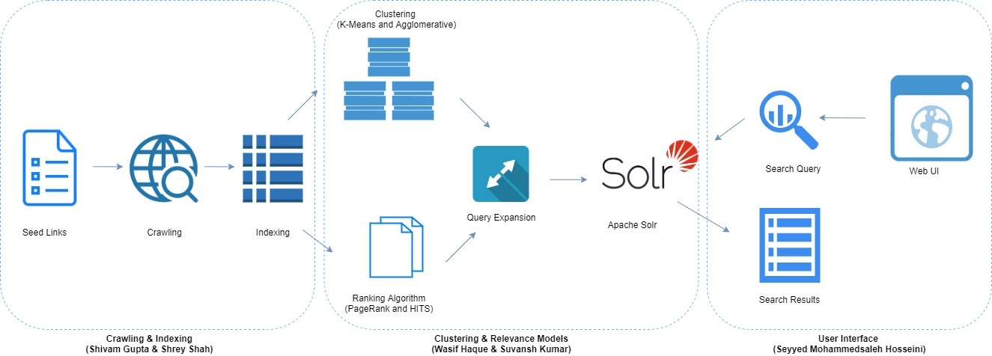
Overview

Slide 3

Crawling
Apache Nutch crawler.
76 seed URLs.
Crawling steps
Injecting seed URLs
Generating segments for the list of injected URLs
Parsing web pages.
The crawler generates
CrawlDB - All URLs parsed by Nutch.
LinkDB - Outgoing and incoming URLs for every link.
Segment - List of URLs to be crawled or being crawled.

Slide 4

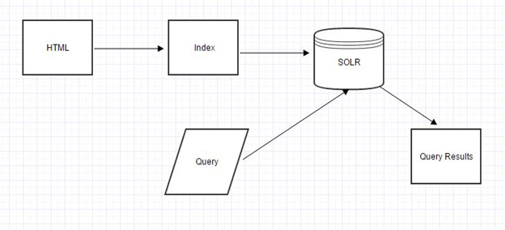
Indexing & Relevance
Apache Solr is used for indexing.
The indexing command takes the content from crawldb and passes it to IndexWriter plugins which has Solr set as the indexer.
Nutch command is used to generate webgraph.
Figure: Index Creation Flow Diagram

Slide 5
Indexing & Relevance
Relevance Models
Vector Space Relevance Model
Solr provides Tf-Idf based vector space models to convert web content to vector space.
PageRank
Inbuilt nutch command is used with damping factor 0.8
HITS
HITS uses hubs and authorities to define a recursive relationship between nodes.

Slide 6
User Interface
Front end: HTML, CSS, JQuery, Bootstrap. Backend: PHP.
Results of the query is displayed in multiple different tabs.
PageRank, HITS, Query Expansion (Association, Metric, Scalar, Pseudo Relevance), Clustering (K-Means, Agglomerative), Vector Space, Google & Bing.
API calls to fetch Google and Bing Search results.
Steps performed when user searches for a query
Read the query
Call Google and Bing API to fetch results.
Send requests to the back-end to get results PageRank, query expansion, clustering, HITS and vector space.
Render JSON results into HTML
Display all the results in different tabs

Slide 7
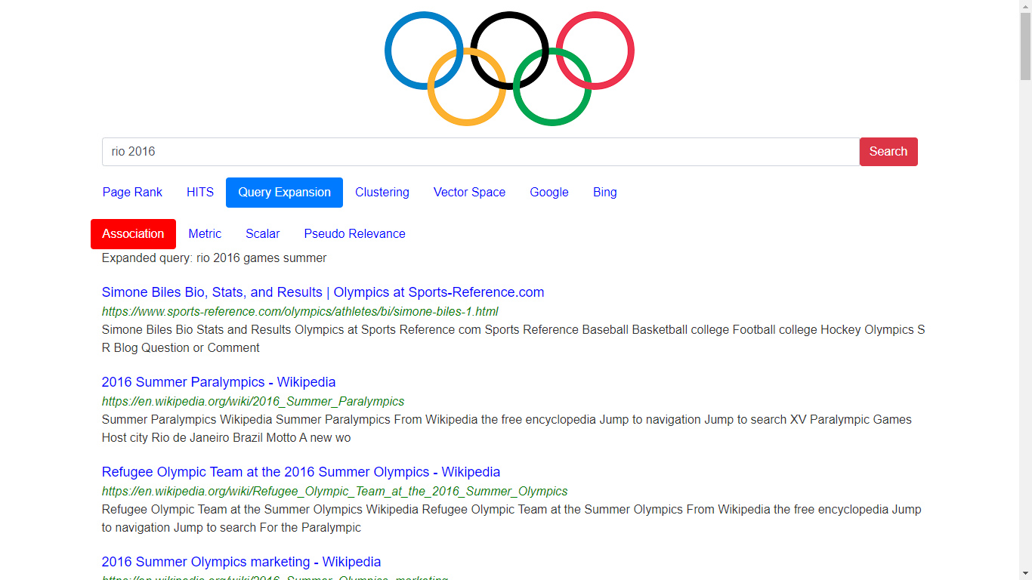
User Interface (Cont’d)

Slide 8
Clustering
Vectorized documents are used for K-Means and Agglomerative clustering to group related documents into different clusters.
Clustered results were stored as a dictionary, mapping URLs to their cluster label.
For a given search query, the results are fetched from Solr and ranked using PageRank.
The stored clustered results are then used to re-rank documents based on documents belonging to the same cluster.
K-Means cluster seems to perform better in practice than agglomerative.

Slide 9
Query Expansion & Relevance Feedback
Rocchio’s Algorithm (offline).
User manually chooses relevant vs non-relevant documents and this information is used to generate an expanded query.
Pseudo Relevance Feedback
All top documents are considered relevant and new terms are added based on the terms with highest weights from the local document set.
Association cluster - terms co-occurring frequently.
Metric cluster - terms occurring far apart are less correlated than ones that occurring closer
Scalar cluster - terms having similar neighborhoods.

Slide 10
THANK YOU

